Slide 1

Undocumented Hacking
José Alberto Martinez
@bluejosem

Slide 2
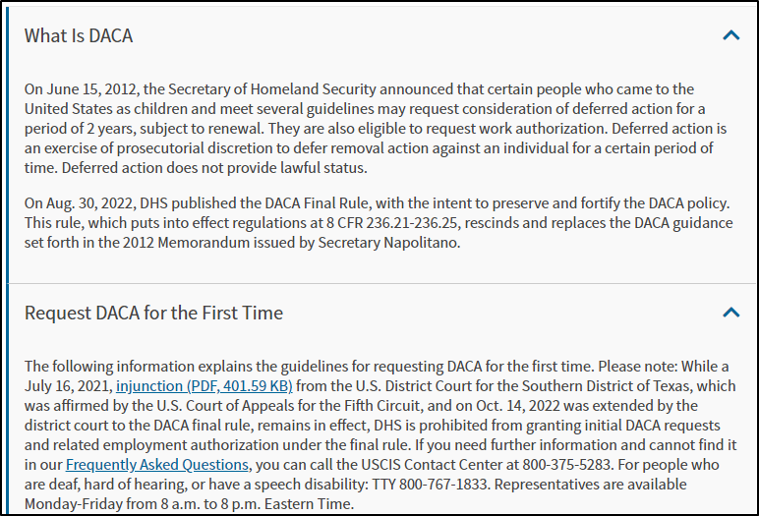
Background
Pentester
Undocumented, with DACA work permit
Not technically status, no clear path to adjust status
Not a law, not ‘papers’
Discretionary action, executive action
Lots of lawsuits
Renewal every 2 years ($555 or $605)
Notes:
Immigration law is overly complex, strict, and sometimes ambiguous

Slide 3
How I got into security
Was working retail and school
Some college and community college at time
Pilot security bootcamp at Chicago City Colleges, certs
Just fact was studying for certs helped get first support role at local electric and networking equipment company
Knowledge, messing with things, and personal home lab helped
Found out about apprenticeship program at local consulting company
Was doing well, but initial HR contact didn’t know what DACA was
Almost ended, but pushed back, interview process reset, passed
Being your own advocate
Completed apprenticeship, where started pentesting, currently senior analyst

Slide 4

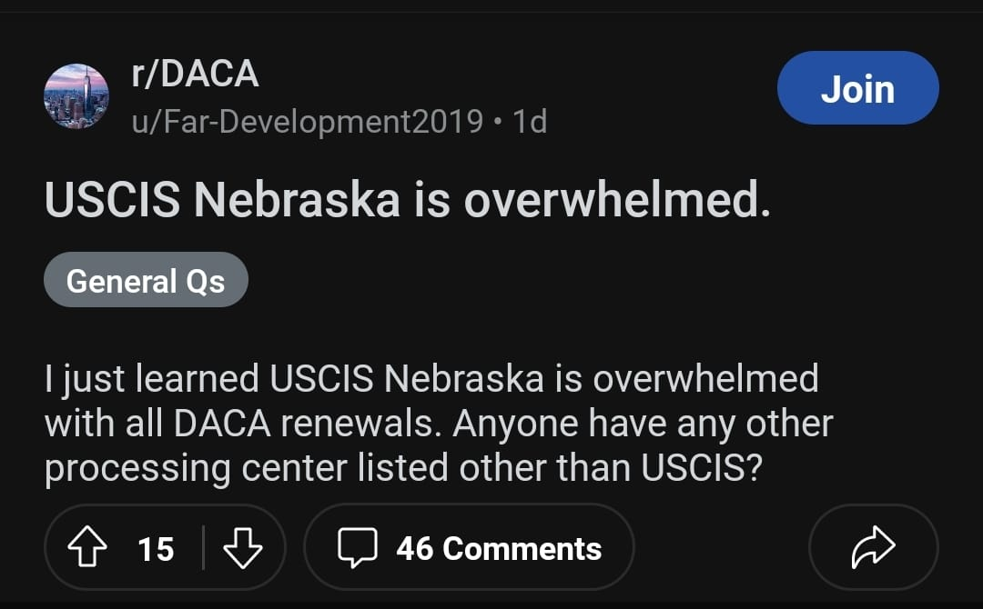
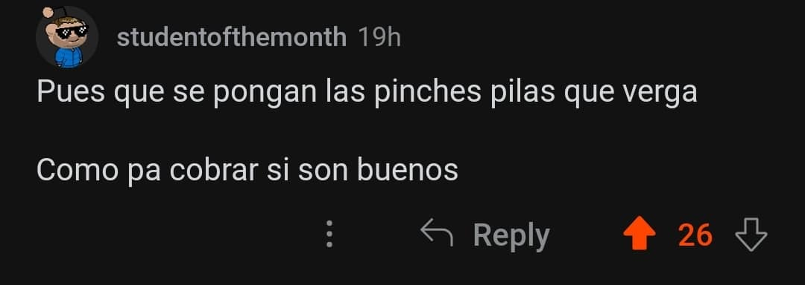
Barriers to entry
For immigration purposes, non-criminal incidents or misdemeanors can become ‘felonies’.
No right to a lawyer in immigration court; limited rights
Travel restricted
‘Advance Parole’ fee of $630
DACA originated from activism, which included civil disobediences, actions at Obama campaign offices
Doesn't qualify for financial aid, many costs out of pocket
Many roles have degree requirements
Similarly:
Organizations or clients have limited budget and time constraints
Limited personnel
Limited tooling
Scope…
Notes:
Setting the scene, AND, Hacking is problem solving

Slide 5
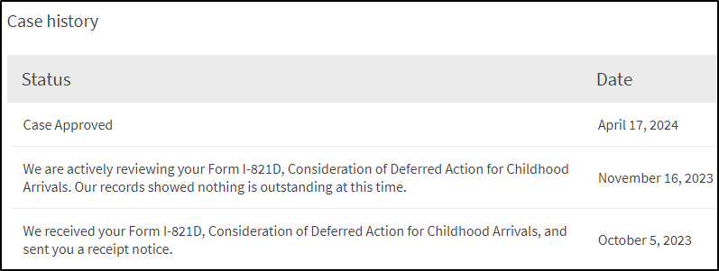
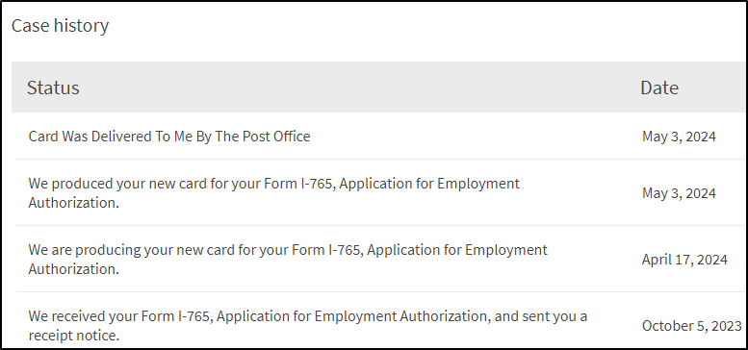
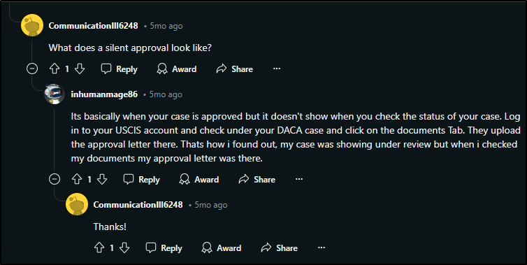
Timeline – Case Study
Problem: applying for renewal, normally short term process dragged into 7 months from 3 to 4. No good indicators on possible completion.
Local senator #1 inquiry Nov. 03, 2023
Followed up Jan. 02, 2024, OOO, contacted backup, no response
Nov. 16th biometrics reuse letter received. Normally this means decision shortly after, not this time.
Called USCIS Jan. 22, 2024, told to file online inquiry. Response from that Feb. 12 said in line to be reviewed by officer
Submitted inquiry to other senator March 03, 2024
03/13/24 Submitted form to CIS Ombudsman for assistance; alternate escalation path
04/15/24 Called, did “infopass” bot bypass to speak to physical agent. Otherwise unavailable option. Another online inquiry form per agent, said they made note on case.
Had started to find lawyer info for ultimate escalation, Mandamus Lawsuit, case approved before did this
Had case status reset a couple of times, before being stuck on ‘outside of normal processing timeline’ status; before approval
Notes:
Don’t really cover this, just have as reference, focus on the concepts

Slide 6
Hypothesis
Does this system work how think it does?
“Cooling off period”?
What accelerates case progress?
OODA loop, Observe, Orient, Decide, Act

Slide 7
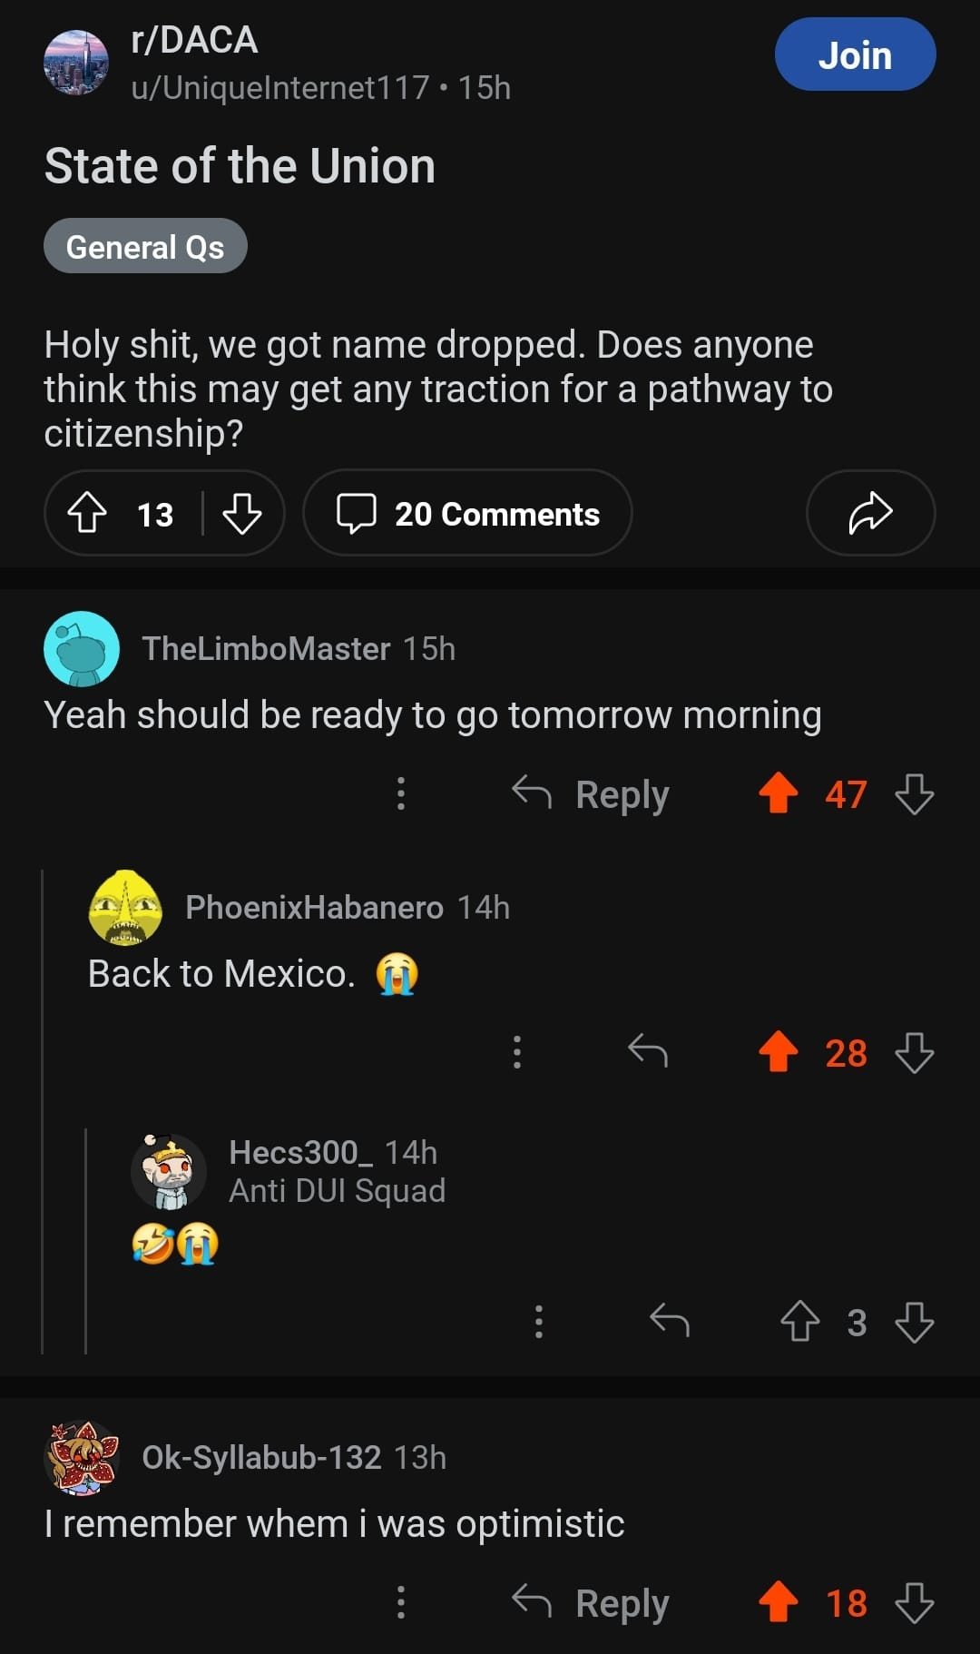
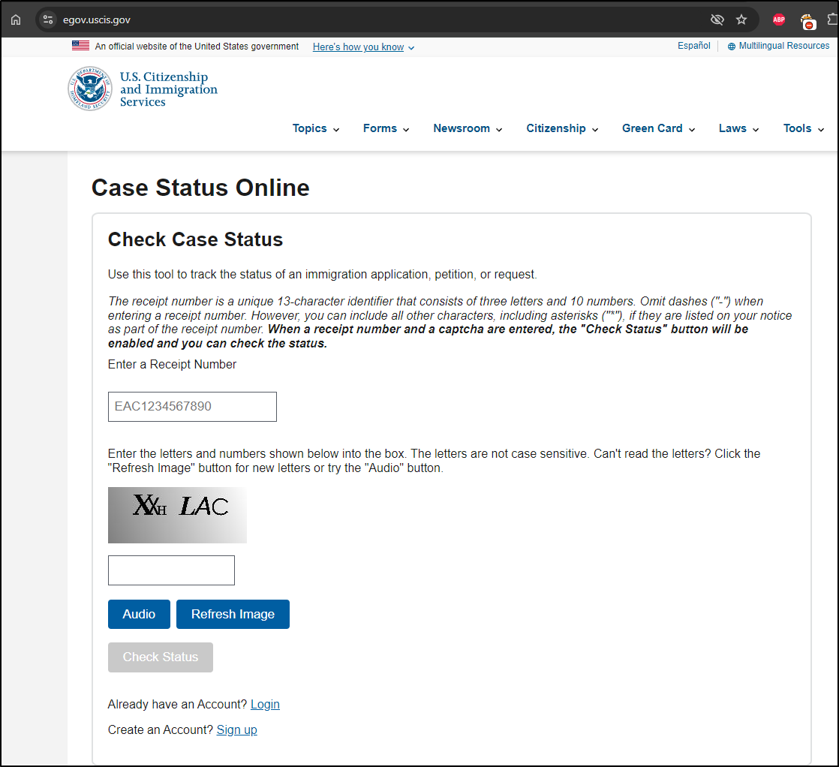
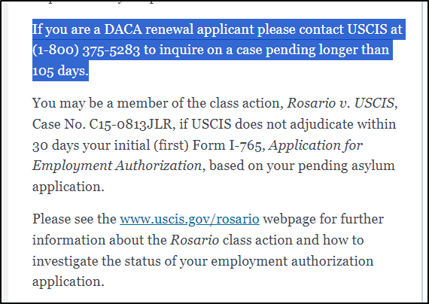
Information Gathering
Hacking is problem solving, approach like a hacker
Reddit and other searches for anecdotal evidence of case timelines
Digging through documentation, USCIS sites, estimates, and case trackers
Parsing for undocumented unofficial indicators of case progress
Finding side channel solutions or escalations
Expected timelines on case status will randomly reset, no patterns
USCIS internal processes are essentially a gray box
Notes:
Hacking is testing against the unknown or partially known, black box and gray box
Expectations are not reality

Slide 8
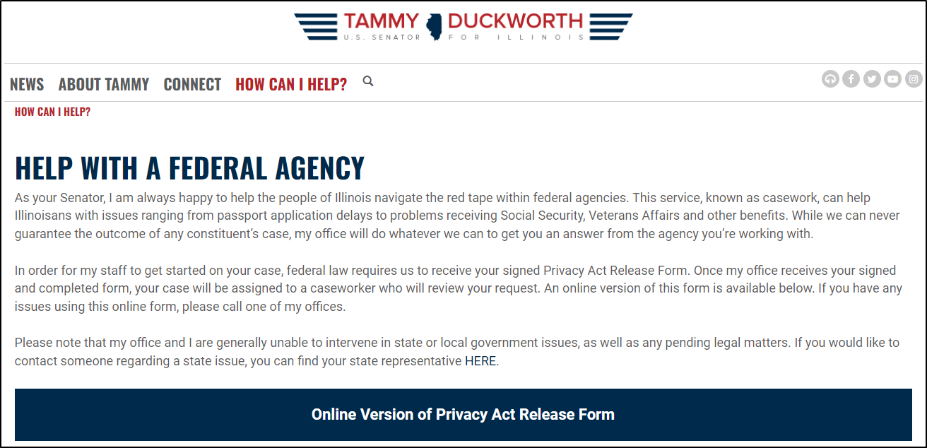
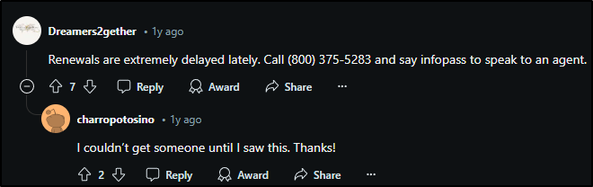
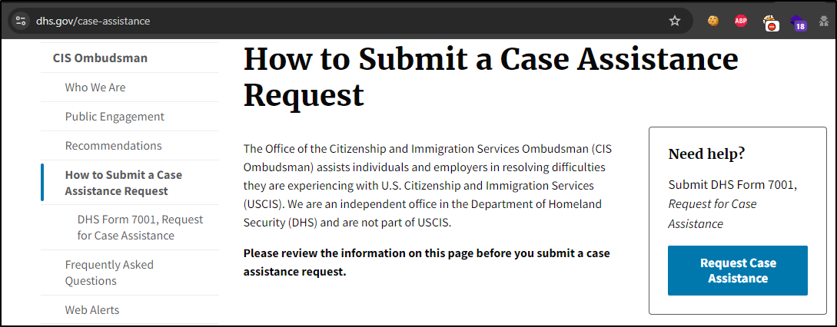
Bypasses, Options
Bypassing the system: things that might help
Bypassing voice chat (see screenshot)
Congressional inquiries via:
Senators, congress-people, etc
Can be non-standard, some have better web forms or processes
White House Inquiry
Ombudsman escalation
Nuclear option: Writ of Mandamus
Notes:
Community helping each other, like when search for vulnerabilities or others’ solutions to problems

Slide 9
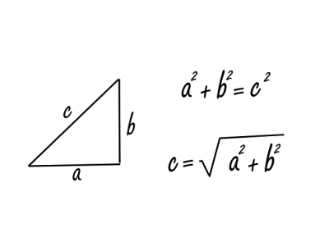
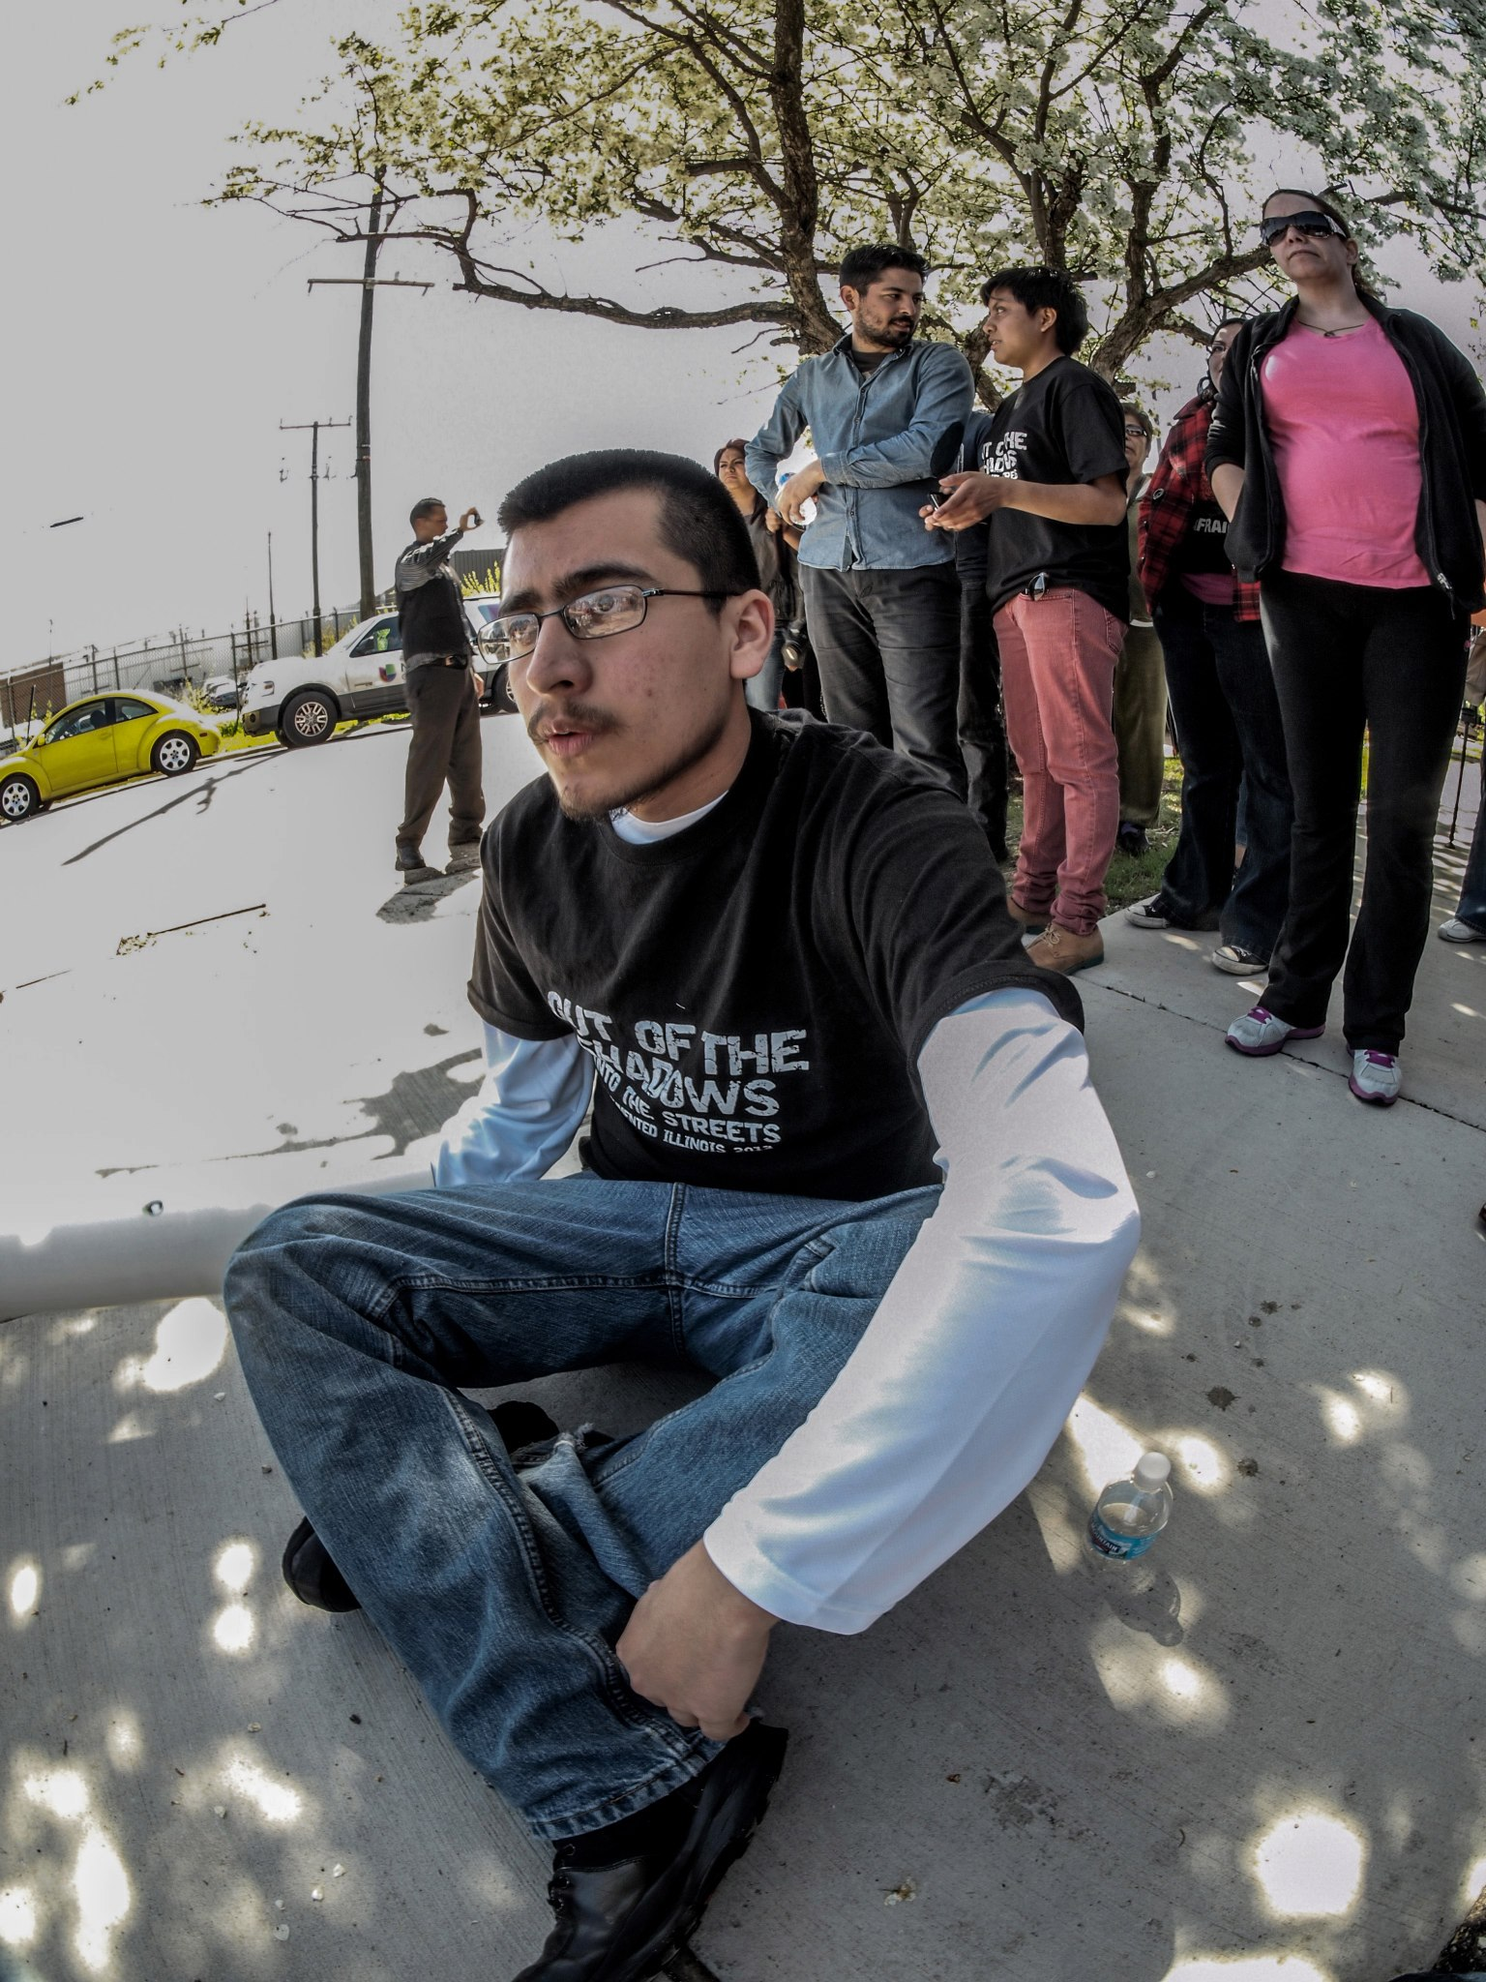
Physical Testing – Civil Disobedience, DACA Origin
Planning, planning, planning
Civil disobedience:
Scope
Escalations, possible consequences
Participants: how much risk are you willing to accept? (Extreme: deported)
Can be very personal --- Parallel to organizations’ security posture and remediation
Google maps, schedules, pictures for size comparisons
Legal observers, markers, and bail or legal fee funds. Emergency contact numbers.
Get out of jail (not) free card
Practice runs and becoming fast at using equipment, lock ins
Banner Drops
Exit strategies
Incident Post Mortem, successes, failures
What’s next?
Distribution of and fostering talent
Trainings

Slide 10
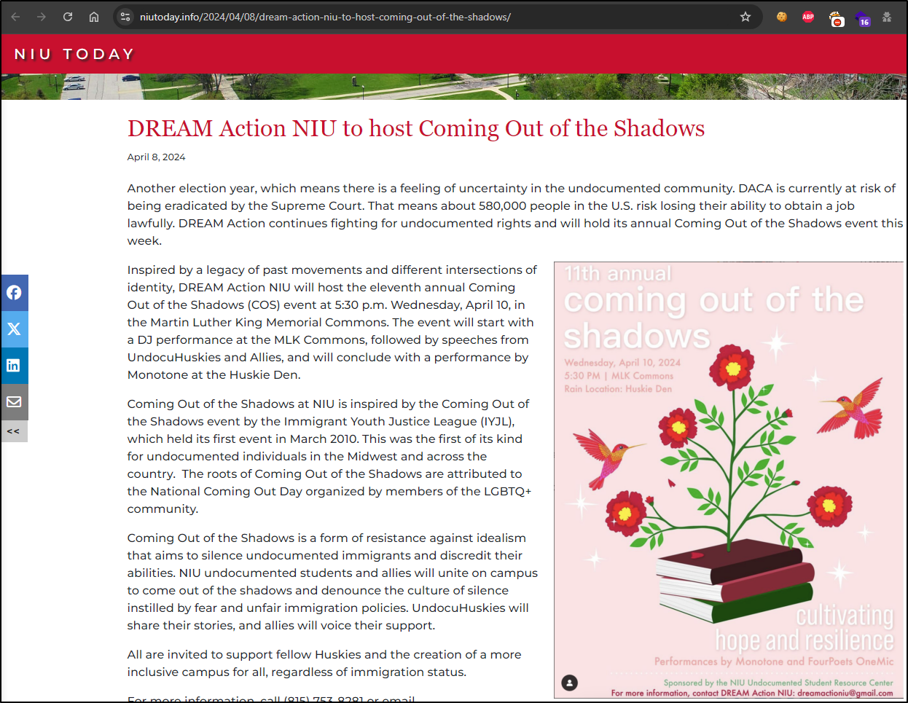
Comms
Meeting minutes should remain private
Plans should have degree of confidentiality
Not unheard of for activists to be monitored, to a certain extent
Inter organization cooperation
March 10, Coming Out of the Shadows
Press Releases, legal advice
Fundraising

Slide 11
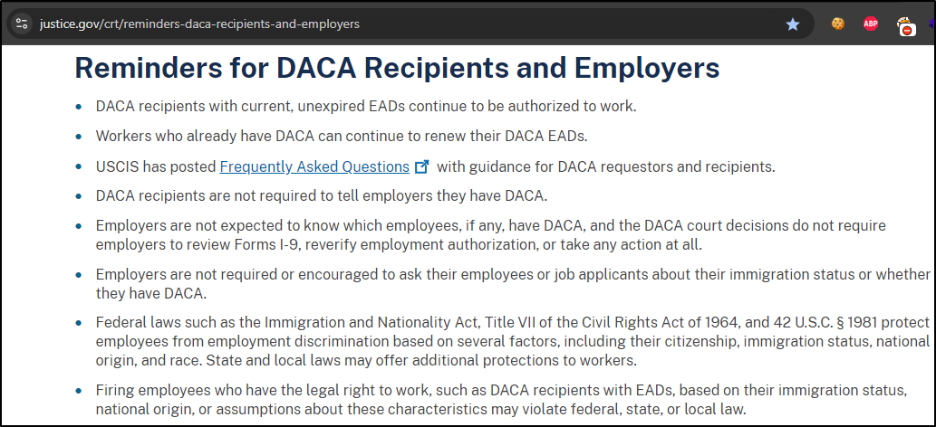
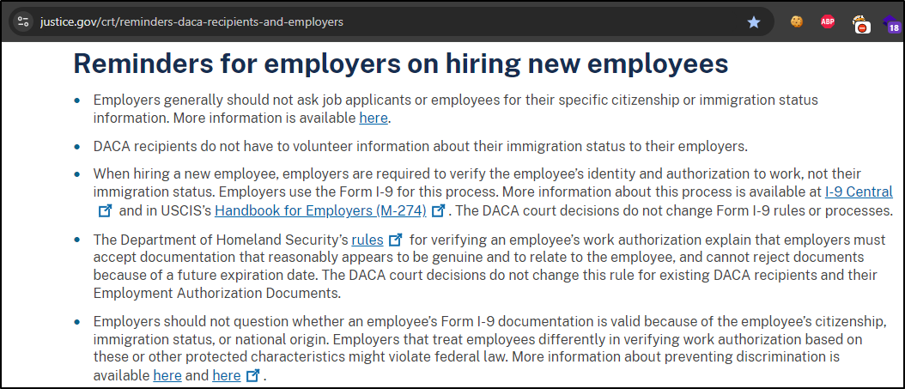
Hiring Talent
Don’t be afraid to hire people with unconventional backgrounds, makes teams more diverse in both composition and knowledge. Community college.
Apprenticeship programs are a good practice, guides on how to start one at your company
If your HR is uninformed about certain work permits or unconventional situations:
Training
Internal escalation process
Could be leaving self open to liability with Justice Dpt. for discriminatory practices

Slide 12
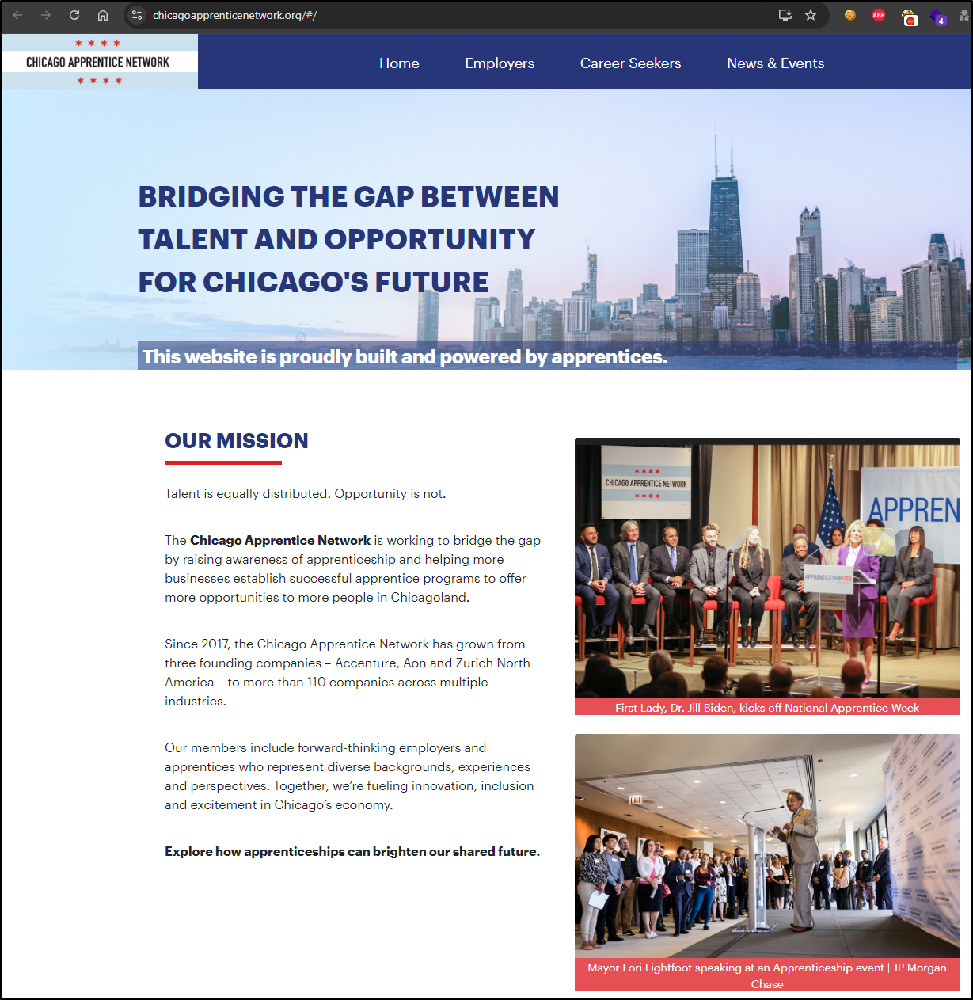
Take Aways
Overlap between immigrant rights activism and hacker culture
Preventing discrimination in hiring practices, intentional or not
Apprenticeship programs
Accommodate non conventional paths, common in security
Lower barriers to entry, security is already hard enough to enter
A lot of these programs have been around for years, proven track record
Know few security practitioners that did apprenticeships successfully

Slide 13
Apprenticeships and Training
Paid on the job learning (important)
Degrees vs certs vs experience
Mentorship
A lot more resources available now:
OWASP vulnerable web apps, docker images
VMs
Learning platforms like Immersive Labs, HTB, TryHackMe
Youtube, blogs, walkthroughs, write ups
Bug bounty programs
Local security meetups, BSides, Discords, etc
Receptive, open, inclusive communities
Certifications and practice make for stronger candidates
Providing on the job learning can fill the experience gap

Slide 14

Why?
“I am, somehow, less interested in the weight and convolutions of Einstein’s brain than in the near certainty that people of equal talent have lived and died in cotton fields and sweatshops.” – Stephen Jay Gould
Untapped potential
DACA not currently taking new applications due to lawsuits
Should be about building up skills and resources
Digital Poverty
For job applications, interacting with government, etc
Brain drains
Notes:
Not just DACA recipients, but those outside processes, other non traditional backgrounds

Slide 15
Thanks
@bluejosem on Twitter and Instagram
@bluejosem.bsky.social on BlueSky
bluejosem.com

